Slide 1
Introduction to Python
MANA AI CHANNEL

Slide 2
Python Variables
Reserved memory locations to store values.
Variable Declaration
int a = 10
Properties:
[1] Variables can only start with a letter or _.
[2] You can assign different values to many variables at a time.

Slide 3
Python Data Types
Integers
Strings – Strings are homogeneous only made of characters
Boolean

Slide 4
Python String Methods
String Slicing
[1] Starting Slicing
[2] Ending Slicing
[3] Starting and Ending Slicing
Functions of Strings
[1] Capitalize
[2] find
[3] split
[4] count
[5] isalpha – To check presence of spaces
[6] dir()

Slide 5
Python List
A data structure in python.
Lists are mutable, or changeable, ordered sequence of elements.
Every element in lists are called as items.
Ex:
List = [1,”John”,”Srinivas”,20.4,55.5]

Slide 6
Functions of List
dir()
append()
clear()
copy()
count()
extend()
index()
insert()
pop()
remove()
reverse()
sort()

Slide 7
List Comprehensive Techniques
List comprehension is an elegant way to define and create lists based on existing lists.
Star = [i for i in “Python”]
>> Star
[‘P’,‘y’,‘t’,’h’,’o’,’n’]

Slide 8
Python Tuple
Stores multiple items in a single variable.
Tuple objects are immutable.
Ex:
tuple = (1, “remove”, 11.1)

Slide 9
Python Dictionaries
Collection of Key Value pairs.

Slide 10
Python Sets
Stores multiple items in a single variable.
A collection which is both unordered and unindexed.

Slide 11
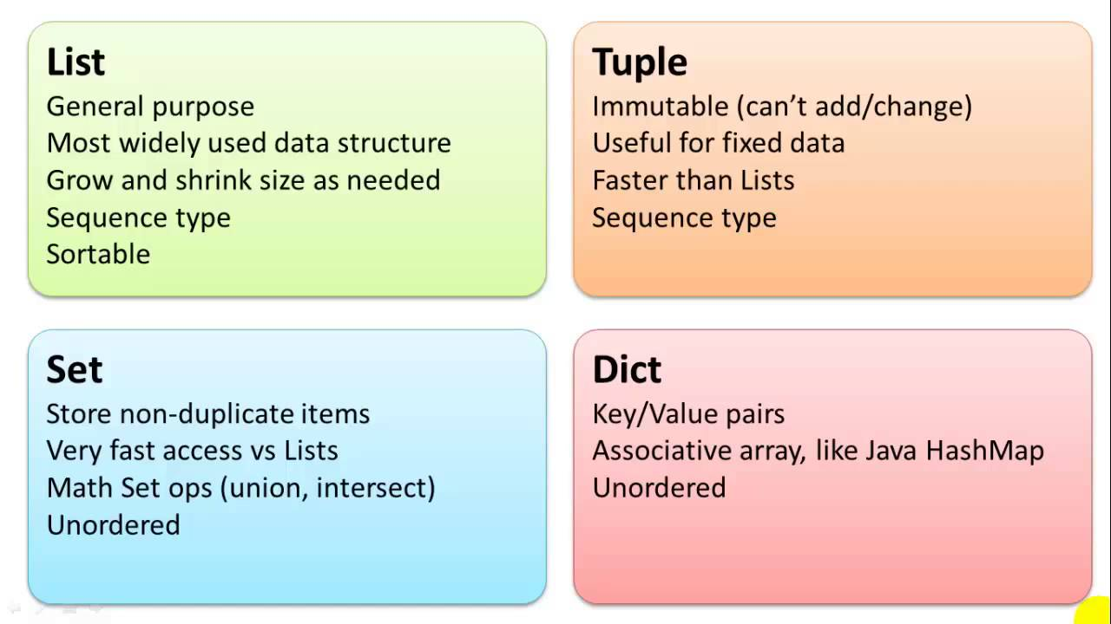

Slide 12
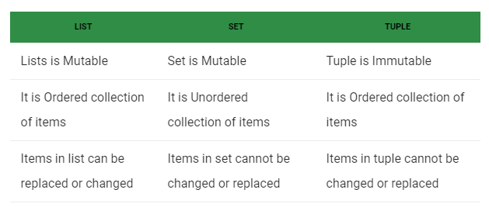
Table of Difference between List, Set and Tuple
Source: https://www.geeksforgeeks.org/difference-between-list-vs-set-vs-tuple-in-python/

Slide 13
To be Continued…
Conditional Statements
Loops
Functions
File Handling

